Slide 1
BEEE-UNIT IV-DIODE: Syllabus
Overview of Semiconductors, PN junction diode and Zener diode–Diode circuits: rectifiers (bridge type only), filters, clippers and clampers.

Slide 2
What is Electronics?
Electronics is the branch of science that deals with the study of flow and control of electrons and the study of their behavior and effects in semiconductor, conductor, vacuum, or gas using such electrons.
The device which controls the flow of electrons is called electronic device.
These devices are the main building blocks of electronic circuits.

Slide 3
Overview of Semiconductors
Semiconductor, any of a class of crystalline solids intermediate in electrical conductivity between a conductor and an insulator.
Semiconductors are employed in the manufacture of various kinds of electronic devices, including diodes, transistors, and integrated circuits.
A semiconductor substance lies between the conductor and insulator. It controls and manages the flow of electric current in electronic equipment and devices.
As a result, it is a popular component of electronic chips made for computing components and a variety of electronic devices, including solid-state storage.

Slide 4
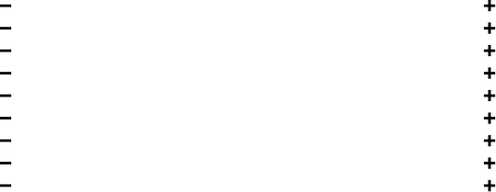
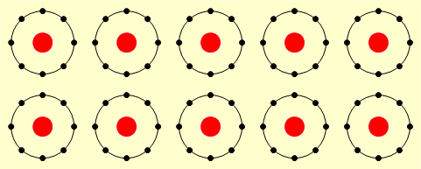
Insulators
Insulators have tightly bound electrons in their outer shell
These electrons require a very large amount of energy to free them for conduction

Slide 5
Let’s apply a potential difference across the insulator above…
The force on each electron is not enough to free it from its orbit and the insulator does not conduct
Insulators are said to have a high resistivity / resistance

Slide 6
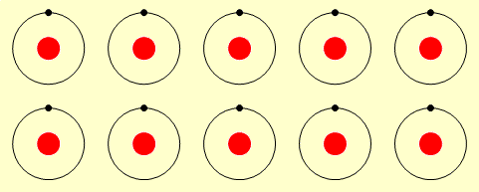
Conductors
Conductors have loosely bound electrons in their outer shell
These electrons require a small amount of energy to free them for conduction
Let’s apply a potential difference across the conductor above…
The force on each electron is enough to free it from its orbit and it can jump from atom to atom – the conductor conducts
Conductors are said to have a low resistivity / resistance

Slide 7
Semiconductors
A semiconductor can be considered a material having a conductivity ranging between that of an insulator and a metal.
A crucial property of semiconductors is the band gap; a range of forbidden energies within the electronic structure of the material.
Semiconductors have a resistivity/resistance between that of conductors and insulators
Their electrons are not free to move but a little energy will free them for conduction
The two most common semiconductors are silicon and germanium

Slide 8
Types of Semiconductors
Semiconductors can be classified as:
Intrinsic Semiconductor.
Extrinsic Semiconductor.
Extrinsic Semiconductors are further classified as:
n-type Semiconductors.
p-type Semiconductors.

Slide 9
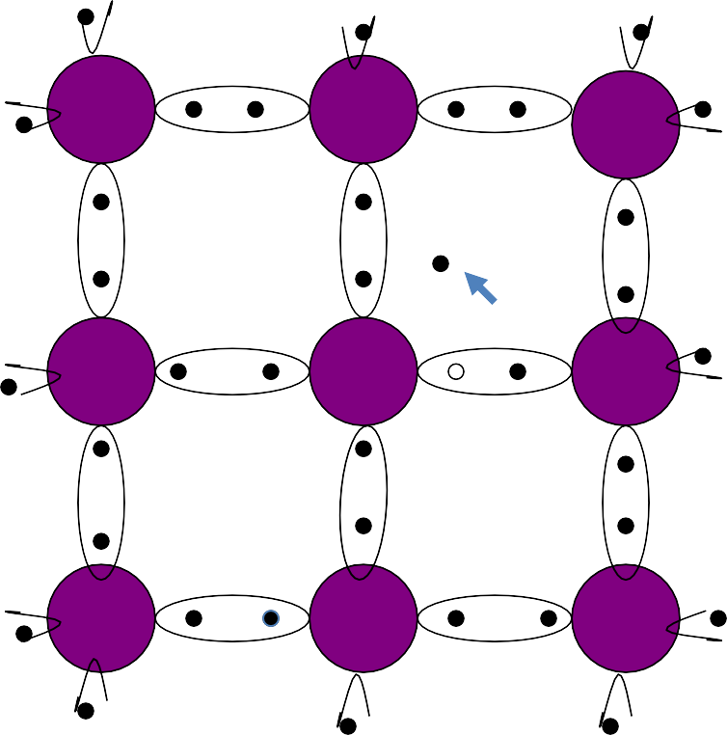
Intrinsic Semiconductor
Semiconductor in pure form is known as Intrinsic Semiconductor.
Si
Si
Si
Ex. Pure Germanium, Pure Silicon.
FREE ELECTRON
Si
Si
Si
At room temp. no of electrons equal to no. of holes.
HOLE
Si
Si
Si
Fig. 1

Slide 10
Extrinsic Semiconductor
When we add an impurity (Doping) to pure semiconductor to increase the charge carriers then it becomes an Extrinsic Semiconductor.
Trivalent elements are Boron(B), Aluminium(Al), Gallium(Ga) forms P-Type Semiconductors
Pentavalent elements are Phosphorus(P), Arsenic(As), Antimony(Sb) forms N-Type Semiconductors

Slide 11
Comparison of semiconductors
Intrinsic Semiconductor
1. It is in pure form.
Extrinsic Semiconductor
It formed by adding trivalent or pentavalent impurity to a pure semiconductor.
No. of holes are more in p-type and no. of electrons are more in n-type.
Fermi level lies near valence band in p-type and near conduction band in n-type.
Holes and electrons are equal.
Fermi level lies in between valence and conduction Bands.
25

Slide 12
N-type Semiconductor
When we add a pentavalent impurity to pure semiconductor we get n-type semiconductor.
Arsenic atom has 5 valence electrons. Fifth electron is superfluous, becomes free electron and enters into conduction band.
Therefore pentavalent impurity donates one electron and becomes positive donor ion. Pentavalent impurity known as donor.
28

Slide 13
Example – N type
No. of pentavalent impurities added to a semiconductor – 100
100 electrons are generated along with 100
+ve immobile ions.
Apart from this lets say 5 thermally generated electron hole pairs are present at room temeperature.
Total number of holes -5 (minority)
Total number of electrons -105 (majority)

Slide 14
P-type Semiconductor
When we add a Trivalent impurity to pure semiconductor we get p-type semiconductor.
Gallium atom has 3 valence electrons.
It makes covalent bonds with adjacent three electrons of silicon atom.
There is a deficiency of one covalent bond and creates a hole.
Therefore trivalent impurity accepts one electron and becomes negative acceptor ion. Trivalent impurity known as acceptor.
31

Slide 15
Example – P type
No. of trivalent impurities are added to a semiconductor – 100
100 holes are generated along with 100 -ve immobile ions.
Apart from this lets say 5 thermally generated electron hole pairs are present at room temeperature.
Total number of Electrons -5 (minority)
Total number of Holes -105 (majority)

Slide 16


P and N type Semiconductors
P
Acceptor ion
Donor ion
N
- ₋ -
- - -
- -
-
-
-
+
+
+
+
+
+
+
+
+
+
+
Minority electron
Majority holes
Majority electrons
Minority hole
Fig 1.

Slide 17
Formation of PN diode (under no Bias condition)
A P-N junction is formed, if donor impurities are introduced into one side, and acceptor impurities into other side of a single crystal of semiconductor.
Initially there are P type carriers to the left side of the junction and N type carriers to the right side as shown in figure.
On formation of PN junction electrons from n-layer and holes from p-layer diffuse towards the junction and recombination takes place at the junction.
And leaves an immobile positive donor ions at n-side and negative acceptor ions at p-side.

Slide 18
Formation of PN diode
Depletion Region
P
N
- | - | - | - | + | + | + | +
- | - | - | - | + | + | + | +
- |  | - | - | + | + |  | +
Fig 2.
Potential barrier
V_{b}

Slide 19
Formation of PN diode
A potential barrier develops at the junction whose voltage is 0.3V for germanium and 0.7V for silicon.
Then further diffusion stops and results a depletion region at the junction.
Depletion region
Since the region of the junction is depleted of mobile charges it is called the depletion region or the space charge region or the transition region.
The thickness of this region is of the order of 0.5 micrometers

Slide 20
Circuit symbol of PN diode
A
K
Fig 3.
Arrow head indicates the direction of conventional current flow.

Slide 21
P-N Junction Diode - Forward Bias
An external voltage, through Battery is applied with
+ve on p-side,
−ve on n- side.
The holes on p-side repelled from the +ve bias,
the electrons on n- side repelled from the −ve bias .
The majority charge carriers driven towards the junction.
This results in reduction of depletion layer width and barrier
potential.
As the applied bias steadily increased from zero onwards the majority charge carriers attempts to cross junction.
Holes from p-side flow across to the −ve terminal on the n-side, and electrons from n-side flow across to the +ve terminal on the p-side.

Slide 22
Forward Bias
As the external bias exceeds the Junction barrier potential (0.3 V for Germanium, 0.7 V for Silicon ) the current starts to increase at an exponential rate.
Now, a little increase in forward bias will cause steep rise in majority current.
The device simply behaves as a low resistance path.

Slide 23

Working of P-N Junction under FB
P
N
V
Potential barrier
Fig. 2 Working of P-N junction
46

Slide 24
Forward Bias - Features:
Behaves as a low resistor.
The current is mainly due to the flow of majority carriers across the junction.
Potential barrier, and the depletion layer is reduced.

Slide 25
VI - Characteristics
I_{F}(mA)
Forward bias
V_{R}(V)
V_{F}(V)
Cutin voltage
I_{R}(uA)

Slide 26
P-N Junction Diode - Reverse Bias
External bias voltage applied with
+ve on n-side,
−ve on p- side.
This Reverse bias aids the internal field.
The majority carriers i.e. holes on p-side, the electrons on n- side attracted by the negative and positive terminal of the supply respectively.
Depletion Region width increases and strengthens the barrier potential.
The increased barrier width prevents the flow of charge carriers
across the junction.
It results high resistance and no current flows in the circuit.

Slide 27
Reverse Bias
Few hole-electron pairs are created due to thermal agitation (minority carriers).
As a result small current flows across the junction called as Reverse Saturation Current I₀
(uA for Germanium, nA for Silicon).
The magnitude of reverse saturation current mainly depends upon junction temperature because the major source of minority carriers is thermally broken covalent bonds.
Further rise in reverse bias causes the collapse of junction barrier called breakdown of the diode.
This causes sudden increase in flow of carriers across the junction and causes abrupt increase in current.

Slide 28
Working of P-N Junction under RB
P
N
Fig.2 P-N Junction Diode working under RB
V
Potential barrier

Slide 29
PN Juntion Diode V-I characterstics
I_{F}(mA)
Forward bias
Breakdown voltage
V_{R}(V)
V_{F}(V)
Cutin voltage (or) Knee Voltage
Reverse Bias
Fig 3.
I_{R}(uA)

Slide 30
Junction Properties
The junction contains immobile ions i.e. this region is depleted of mobile charges.
This region is called the depletion region, the space charge
region, or transition region.
It is in the order of 1 micron width.
The cut-in voltage is 0.3v for Ge, 0.7v for Si.
The reverse saturation current doubles for every 10 degree
Celsius rise in temperature.
Forward resistance is in the order ohms, the reverse resistance is in the order mega ohms.
The Transition region increases with reverse bias. This region also considered as a variable capacitor and known as Transition capacitance

Slide 31
Forward bias characteristics
It is a graph between voltage across the terminals of the device (x-axis) and the current that flows through it (y-axis).
During forward bias gradually increase the voltage in small steps of the order of 0.1 volts. Note the corresponding values of current.
Up to the Knee voltage(0.3 for Ge & 0.7 for silicon) there is no diode current due to the fact that externally applied voltage is opposed by the junction voltage.
As the voltage is increased above the knee voltage, diode current increases rapidly.

Slide 32
Reverse bias characteristics
During reverse bias, reverse resistance is high.
Current is due to minority charge carriers.
Practically no current flows through the circuit.
For large applied reverse bias kinetic energy of electrons become so high & they knock out electrons from semi conductor atoms.
A large number of free electrons are formed which is commonly called as an avalanche of free electrons.
At this stage break down of junction occurs and there is sudden rise of reverse current.
The reverse voltage at which the junction breakdown occurs is known as Breakdown Voltage
Reverse resistance can be calculated from the slope of the curve.

Slide 33
Resistance calculation
I_{F}(mA)
Forward bias
Breakdown voltage
ΔV
I_{f}
V_{r}
ΔI
V_{R}(V)
V_{F}(V)
V_{f}
Cutin voltage
I_{r}
Reverse Bias
Fig 4.
I_{R}(uA)

Slide 34
Resistance calculation
Forward Resistance
Static Resistance (R_{F}): It is the ratio of voltage to current of volt ampere characteristic during forward bias of the diode
Static resistance (R_{F}) = V_{f} /I_{f} …ohms.
Where V_{f,} I_{f} are voltage and current values on Forward characteristics.
AC or dynamic resistance (r_{f}): It is defined as the reciprocal of the slope of V-I characteristic.
AC or Dynamic resistance (r_{f}) = Change in voltage/ change in current
r_{f} = ΔV/ ΔI
..ohms.
Where ΔV, ΔI are incremental voltage and current values on Forward characteristics.

Slide 35
Resistance calculation
Reverse Resistance:
Static resistance (R_{r}) = V_{r} /I_{r} …ohms
Where V_{r}, I_{r} are voltage and current values on Reverse characteristics.

Slide 36
Diode-Variants
Rectifier diodes: These diodes are used for
AC to DC conversion
Over voltage protection.
Signal diodes : Detection of signals in AM/FM Receivers.
Zener diode: Voltage Regulation purpose.
Varactor diode for variable capacitance
Electronic tuning commonly used in TV receivers.

Slide 37
PN Junction Diode
The expression for diode current is given by
V
nV
I = I₀ (e ^{t} −1)
I_{o}=Reverse Saturation current.
V=Applied Voltage.
V_{t}=Volt equivalent of temperature.
η=1 for germanium and
2 for silicon.
Diode forward resistance is very low

Slide 38
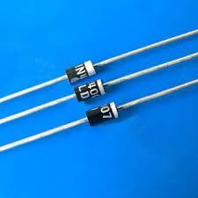
Diode Applications
Diode Acts as a
Switch
Rectifier
Clipper or Limiter
Clamper or DC restorer
Detector etc,
It is analogous to a water pipe that allows water to flow in only one direction.

Slide 39
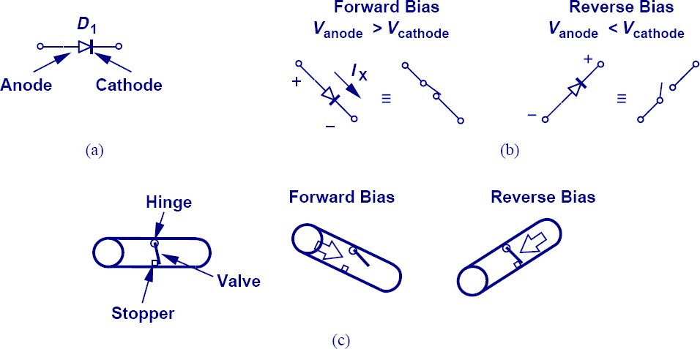
Diode - SWITCH

Slide 40
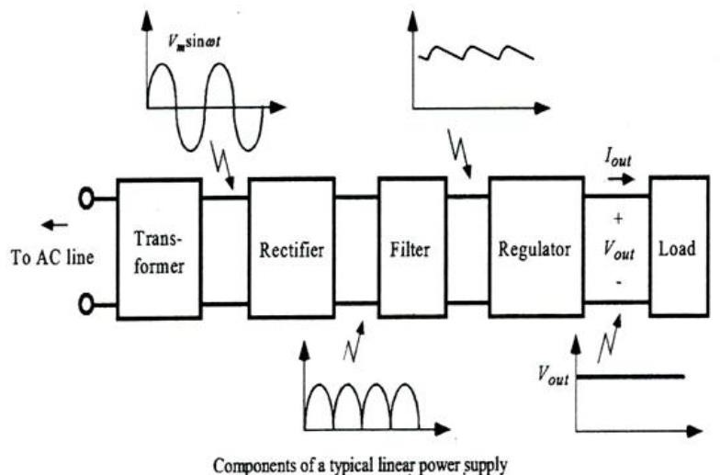
Power Supply - Block Diagram

Slide 41
Rectifiers
Rectifier is a circuit which converts AC voltages and currents in to pulsating DC voltages and currents,
Output of a rectifier consists of DC component and
unwanted AC component.
Un wanted AC component which is present at the output of a rectifier is known as Ripple.
Ripple can be eliminated by using filter circuits,
Output of a filter circuit is steady state DC voltage.

Slide 42
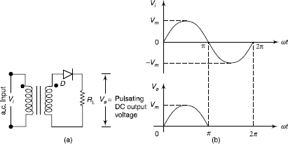

Slide 43
Half Wave Rectifier
Construction :Half wave rectifier circuit consists of a step down transformer ,a Diode and a load resistance.
Principle :Half wave rectifier circuit converts alternating voltage or current to pulsating voltage or current for half period of input cycle.
Hence it is named as Half wave rectifier .

Slide 44
Half wave rectifier - Operation
During the positive half cycles of ac input voltage, the diode D is forward biased,
It offers low resistance and it acts as a CLOSED switch
During the negative half cycles of ac input voltage, the diode D is reverse biased,
It offers high resistance and it acts as an OPEN switch .

Slide 45
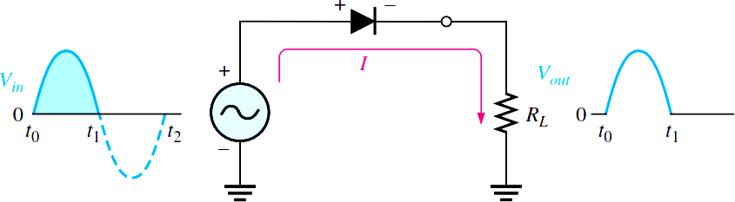
HWR during Positive Half cycle

Slide 46
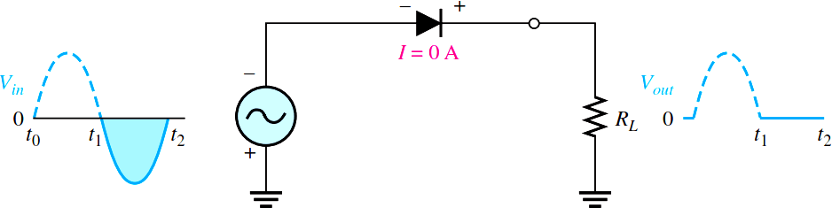
HWR during Negative Half cycle

Slide 47
Analysis of HWR
Rectifier circuit can be analyzed by calculating the following values.
Ripple Factor
Efficiency
Peak Inverse Voltage
Transformer utilization Factor
Form factor
Peak Factor

Slide 48


Mathematical Analysis of Half Wave Rectifier
The input sinusoidal voltage applied at the input of transformer is given by
The Diode current or load current is given by
Maximum current
R_{f} = Forward resistance of the diode
R_{L} = Load resistance of the diode

Slide 49
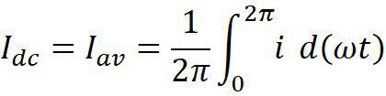
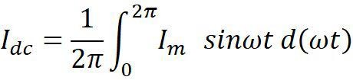
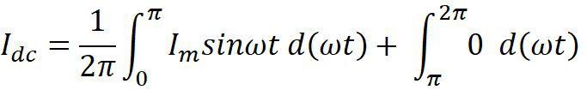


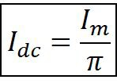
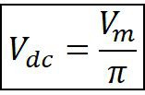
DC or Average value of CURRENT & VOLTAGE

Slide 50
Root Mean Square Value (HWR)
Effective or RMS value of an AC quantity is the equivalent DC value which produces the same heating effect as the alternating component.
It is defined as a steady state unidirectional current (DC) which when passed through a resistor for a definite interval of time produces the same amount of heat as the given AC produces when passed through the same resistor for the same period of time through a resistor.

Slide 51
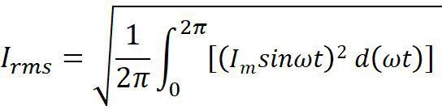

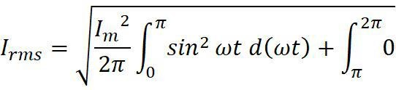
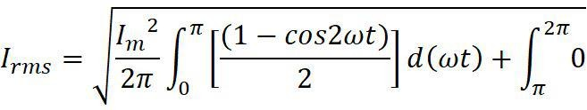
Root Mean Square Value (HWR)

Slide 52
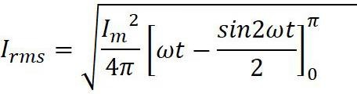
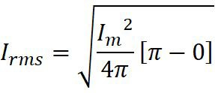
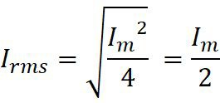


Root Mean Square Value (HWR)

Slide 53
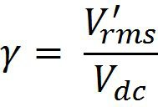

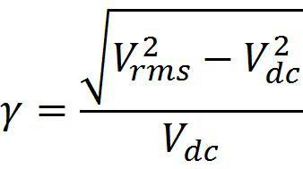
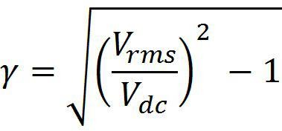
Ripple Factor (HWR)
Ripple factor is defined as the rms value of ac voltage to the dc voltage.
Ripple factor has no unit of measurement.

Slide 54


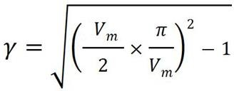
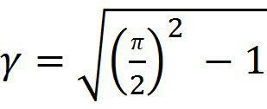
Ripple Factor (HWR)
= 1.21

Slide 55



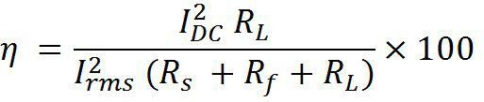
Efficiency of HWR
The ratio of output DC power to the input AC power is defined as efficiency.
DC output power =
AC input power =
Efficiency,

Slide 56
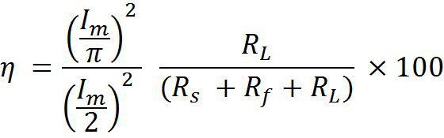



Efficiency of HWR

Slide 57
Peak Inverse Voltage (HWR)
Peak inverse voltage is the maximum reverse voltage that the diode can withstand during reverse bias conditions.
In a HWR the peak inverse voltage equals the peak value of
the applied voltage.
PIV=V_{m}

Slide 58


Transformer Utilization Factor
It is defined as the ratio of DC power delivered to the load to the AC rating of transformer secondary.
The variation of DC output voltage as a function of DC load current is called 'regulation'

Slide 59
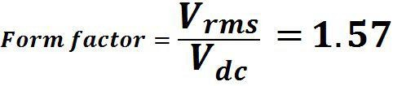



Form factor (F.F) is the ratio between RMS value and average value,
Peak factor (P.F) is the ratio between Max value and RMS value,

Slide 60
Advantages and Disadvantages of HWR
Advantages
– It is simple and Low cost circuit.
Disadvantages
Low rectification Efficiency (40.6)
Ripple factor is high (1.21) 3. Low TUF (0.287)
DC saturation of the Core
Poor Regulation

Slide 61
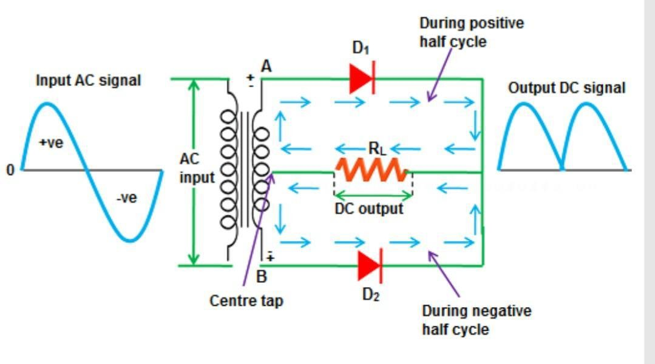
Full Wave Rectifier
There are two types of full-wave rectifiers,
(i) FWR with center tapped transformer,
(ii) Bridge rectifier.

Slide 62
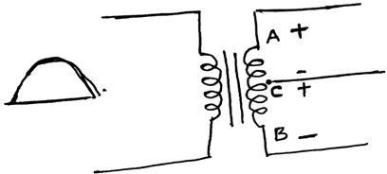
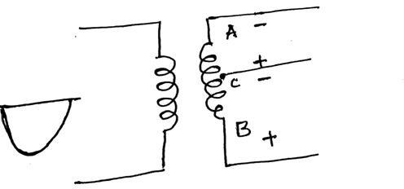
Center Tap Transformer - Action
During Positive Half cycles
During Negative Half cycles

Slide 63

Full Wave Rectifier - Operation
Construction: Full wave rectifier consists of two diodes, a center tap transformer and a load resistance.
Operation : During Positive half cycles of the applied ac input voltage due to the center tap action end ‘A’ will become positive with respect to end B.
Hence Diode D1 forward biased and Diode D2 reverse biased .Hence current Conduction is due to D1 only.
Current path is given by
Current flowing through the load resistance is i₁

Slide 64

Full Wave Rectifier - Operation
Operation : During Negative half cycles of the applied ac input voltage due to the center tap action end ‘B’ will become positive with respect to end A.
Hence Diode D1 Reverse biased and Diode D2 Forward biased .Hence current Conduction is due to D1 only.
Current path is given by
Current flowing through the load resistance is i₂

Slide 65
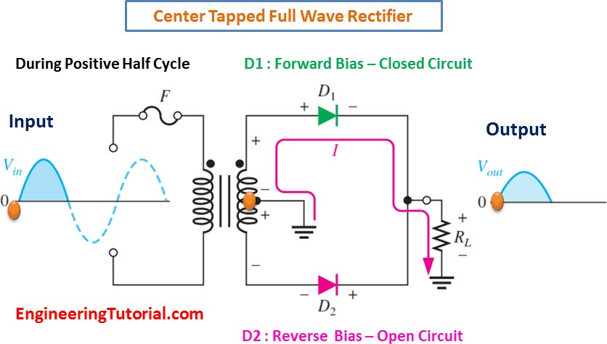

Slide 66
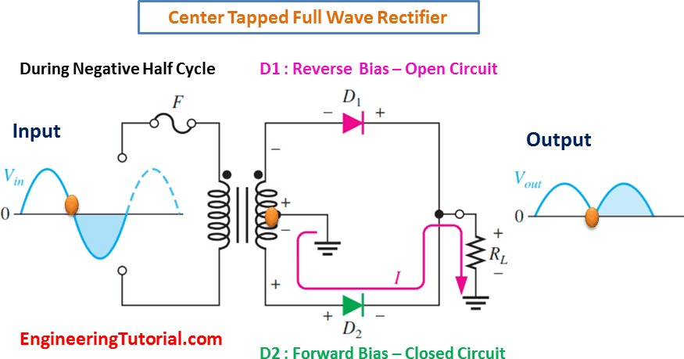

Slide 67
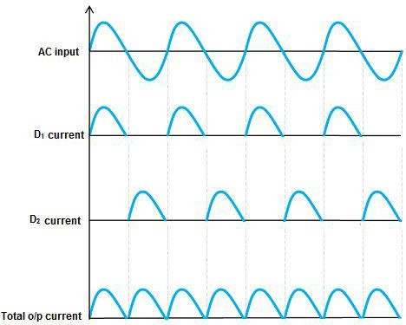
FWR Output Current
Total current flowing through the load resistance is the sum of the individual currents i₁and i₂ .

Slide 68
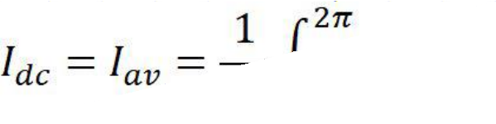
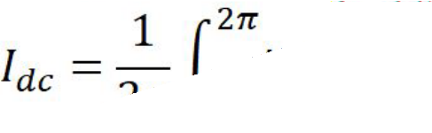


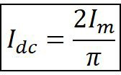
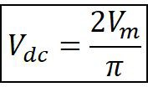
DC or Average value of FWR

Slide 69
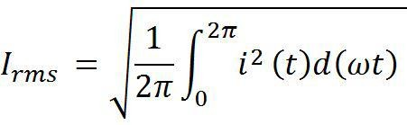
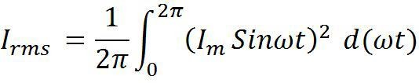



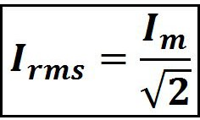
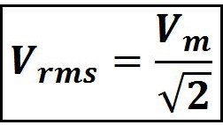
RMS value of FWR

Slide 70
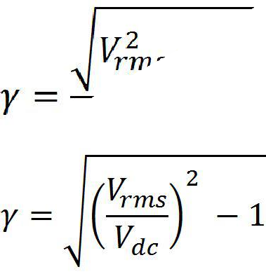
Ripple Factor (FWR)
Ripple factor is defined as the rms value of ac voltage to the dc voltage. Ripple factor has no unit of measurement.

Slide 71


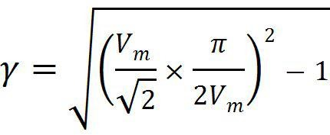
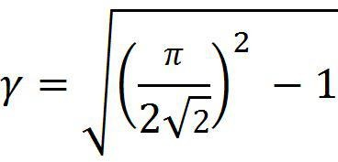
Ripple Factor (FWR)
=0.482

Slide 72
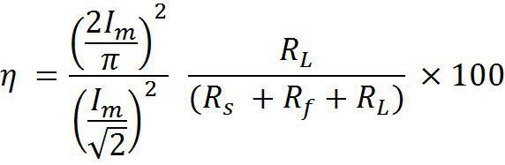
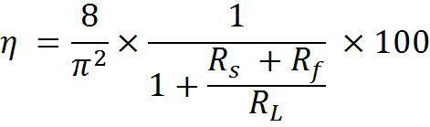

Efficiency of FWR
Efficiency is defined as the ratio of DC power output to the AC power input.

Slide 73
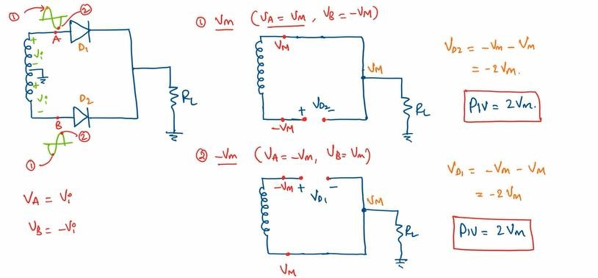
Peak Inverse Voltage
It is the maximum reverse voltage that the diode can withstand during reverse bias conditions.
Maximum voltage at the upper part of the Transformer is V_{m} and the voltage drop across load resistance is V_{m} due to conducting diode.
Hence the total voltage in the lower part of the Transformer is 2 V_{m}.

Slide 74

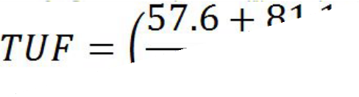
Transformer Utilization Factor
Transformer utilization factor of the primary winding
=2*Transformer utilization factor of the HWR
=2*28.8%=57.6%
Transformer utilization factor of the secondary winding
= 81.1%
TUF of full wave rectifier is the average of primary and secondary windings.
TUF=0.692

Slide 75
Advantages and Disadvantages of FWR
Advantages
Efficiency is high.
Low ripple factor.
Dc saturation of the core is avoided.
Good regulation.
High TUF
Disadvantages
Due to center tap transformer system is bulky.
PIV of the diode is high. (Higher PIV diodes are larger in size and too much costlier).
It is costly.

Slide 76

CHARGER - Application of FWR

Slide 77

FWR - Bridge Rectifier

Slide 78
FWR - Bridge Rectifier
Construction: Bridge rectifier consists of four diodes, transformer and load resistance.
Four diodes are arranged in the form of a bridge.
AC voltage to be rectified is applied to the primary of transformer.
Voltage appeared at the secondary winding of transformer is applied to the two ends of the bridge.
Other two ends of the bridge are connected to the load resistance.

Slide 79
FWR - Bridge Rectifier
During Positive half cycles of the applied ac voltage end ‘A’ becomes positive with respect to end ‘B’.
During positive half cycles diodes D1 and D2 are forward biased and acts as closed switches. D3 &D4 are Reverse Biased.
Current path is as shown in the figure.

Slide 80


Slide 81
FWR - Bridge Rectifier
During Negative half cycles of the applied ac voltage end ‘A’ becomes negative with respect to end ‘B’.
During negative half cycles diodes D3 and D4 are forward biased and acts as closed switches. Diodes D1 and D2 Reverse biased and acts as open switches.
Current path is as shown in the figure.

Slide 82


Slide 83
FWR - Bridge Rectifier
In both the cases current flows in the same direction.
Hence there exists unidirectional current.
Ripple frequency of the output is twice that of fundamental frequency.
Derivations of Bridge rectifier is same as that of center tap full wave rectifier.
Transformer utilization factor =0.81

Slide 84
Bridge Rectifier Advantages and Disadvantages Advantages
DC saturation of the core is avoided.
Centre tap transformer is not required. (Circuit is not Bulky)
TUF is higher compared to FWR.
Peak inverse voltage is only V_{m}.
Disadvantages
Four diodes are required.

Slide 85

Comparison of Rectifiers

Slide 86
Filters
Half Wave Rectifier with shunt Capacitor filter.
Construction : It consists of a Diode, capacitor connected in shunt with the output of a half wave rectifier and across a resistor.
Operation: during the positive half cycles of AC input, diode D is forward biased and it acts as a switch and directly connects secondary across ‘C’.
Capacitor charges to Peak value of the input voltage.

Slide 87

HWR with shunt Capacitor filter
The property of a capacitor is that it allows AC component and blocks the DC component.
The operation of a capacitor filter is to short the ripple to ground but leave the DC to appear at the output when it is connected across a pulsating DC voltage.

Slide 88

HWR with shunt Capacitor filter

Slide 89
HWR with shunt Capacitor filter
When the voltage across capacitor c is V_{c}=V_{m} the voltage at the cathode of the diode is V_{m} and it reverse biases the diode for next half of the positive half cycle and negative half cycle of the diode.
In this duration capacitor discharges through load resistance.
If high value of load resistance is selected discharge is prolonged to obtain a smoother wave form.
This Discharge of the capacitor continues till the voltage at the anode of the diode exceeds the capacitor voltage during next positive half cycle.
This process continues for every cycle and it reduces the ripple.

Slide 90

HWR with shunt Capacitor filter

Slide 91






HWR with shunt Capacitor filter
Mathematical Analysis
The amount of charge lost by the capacitor when it is discharging = l_{dc}.T₂.
Because, l_{dc} is the average value of the capacitor discharge current.
This charge is replaced during a short interval T₁ during which the voltage across the capacitor changes by an amount = peak to peak voltage of the ripple V' _{rpp'}

Slide 92




HWR with shunt Capacitor filter
Total time period T= T at charging + T at Discharging
Therefore,

Slide 93






HWR with shunt Capacitor filter
The ripple waveform will be triangular in nature and the rms value of the ripple is given by
Ripple factor,

Slide 94

FWR with shunt Capacitor filter

Slide 95


FWR with shunt Capacitor filter

Slide 96



FWR with shunt Capacitor filter
The charge it has acquired = V_{r, p–p} × C
The charge it has lost = I_{dc} × T₂
Therefore, V_{r, p–p} × C = I_{dc} × T₂
If the value of the capacitor is fairly large, or the value of the load resistance is very large, then it can be assumed that the time T₂ is equal to half the periodic time of the waveform,
The ripple waveform will be triangular in nature and the rms value of the ripple is given by

Slide 97





FWR with shunt Capacitor filter
From the above equations, we have

Slide 98

Bridge Rectifier with shunt Capacitor filter

Slide 99

FWR with shunt Capacitor filter

Slide 100

FWR with Series Inductor Filter
Inductor has a property of opposing the change in current that flows through it.
When there occurs a change in current , a back emf will be induced in the Inductor
Thus this back emf prevents the current from changing its value.
Thus all the sudden changes in current that occurs in the circuit will be smoothened by placing an inductor in the circuit

Slide 101



FWR with Series Inductor Filter
Inductor
Passes low frequency signals
Blocks high frequency signals
𝑋_{𝐿} = 𝜔𝐿 = 2𝜋𝑓𝐿
what will happen if a dc
signal is provided i.e. 𝑓 = 0.
It means that the reactants offered is 0. 𝑋_{𝐿} = 0
That means it will smoothly pass all the low frequency signals or the DC signal.
And at the same time it will be blocking high frequency signals.

Slide 102
FWR with Series Inductor Filter
HWR gives 121 % ripple and using filter circuit for such high ripple factor has no meaning.
FWR gives 48% ripple and by using filter circuit we can improve
it. Inductor filter is used with FWR circuit.
The Inductor L is connected in series between the Full wave rectifier circuit and the load.
The inductor carries the property of opposing the change in
current that flows through it.
Inductor is a short circuit for DC and offers some impedance for
A.C. (X_{L} = j𝜔L).
When current passes through an inductor, it offers high
resistance to AC component and low resistance to DC.
Thus AC component is blocked and DC component only reaches the load.

Slide 103
FWR with Series Inductor Filter
The output voltage of the full-wave rectifier is expressed using Fourier series as follows,
The output voltage V_{o} consist of DC component and AC components.
In above equation the term ‘𝜔’ indicates frequency components (2𝜔 and 6𝜔 and so on)
These frequency components are called harmonics.
The third and higher harmonics are neglected.
Hence the ac voltage (also called ripple) is mainly due to second harmonics. Hence eq(1) is re-written as,

Slide 104






FWR with Series Inductor Filter
Neglecting diode forward resistance , resistance of choke and transformer secondary resistance for sake of simplicity
From eq(2),
The DC voltage component is,
And hence DC current in the load(R_{L}) is given by
AC component of output voltage
and AC current is
Where,

Slide 105

FWR with Series Inductor Filter
Peak Voltage across rectifier and peak voltage across load is not matching, as there is a lag.
AC current is redefined as,
(Where ∅ is the angle by which the load current lags behind the voltage)
Hence total current flowing through load is given as

Slide 106






FWR with Series Inductor Filter
The expression of ripple factor:
(Where, I_{r, rms} is RMS value of ripple current. In this case, RMS value of I_{ac})
&
Ripple factor:

Slide 107


FWR with Series Inductor Filter
Usually the value of is re-written as,
, hence the above equation
𝛾 =
2
x
1
=
2
x
1
2𝜔𝐿
3 2
3 2
4𝜔²𝐿²
𝑅_{𝐿}
𝑅_{𝐿}
2
_{x} 1
𝛾 = ^{𝑅𝐿}
3 2 𝜔𝐿

Slide 108
FWR with Series Inductor Filter
Therefore, for higher values of L, the ripple factor is low.
If R_{L} is large, then also 𝛾 is high.
Hence inductor filter should be used where the value of R_{L} is
low.
An inductor stores magnetic energy when the current flowing through it is greater than the average value and releases this energy when the current is less than the average value.

Slide 109


ZENER DIODE
Symbol of Zener Diode:

Slide 110
Zener Diode
Zener Diode is a heavily doped PN Junction diode.
During forward bias conditions it behaves like ordinary PN junction diode.
When the doping is high, depletion region width is narrow and
electric field strength 𝐸 = − ^{𝑉} is high during reverse bias.
𝑑
Its electric field strength is high.
When the doping is high even for small reverse voltages also Electric field strength is strong and it causes the breakage of covalent Bonds. This effect is Known as “Zener Effect”.

Slide 111
Zener Diode
Zener break down occurs in junctions which is heavily doped and have narrow depletion layers.
The field is strong enough to rupture the covalent bonds
causing new electron hole pairs to generate.
Zener break down occurs at low reverse voltages only.
When reverse voltage across a zener diode exceeds the zener break down voltage, current increases very sharply.
Current increases very sharply and voltage across Zener diode is constant.
This feature is utilized in Voltage regulators.
Applications
Voltage stabilizers.
Peak clippers.

Slide 112

V–I Characteristics of Zener Diode
Current during reverse bias is due to minority charge carriers.
As the reverse voltage is increased break down occurs at the knee voltage and current increases rapidly.
Maximum permissible value of current on the reverse characteristic is designated as I_{zmax}
Minimum permissible value of current
^{is I}zmin
Between maximum and minimum values of current (Half of the linear region of the characteristic curve) there exists I_{z}
This region is generally considered for regulation purpose.

Slide 113
Break Down Mechanisms
Avalanche Break Down
Zener Break Down

Slide 114
Zener Break down (highly Doped PN)
Zener Diode is Highly Doped PN Junction Diode. Hence, it has very thin depletion region and the Narrow depletion region generates strong Electric field.
This strong electric field with applied reverse voltage will become more strong and causes rupture of the electron from its covalent bond.
This process produce a large number of electrons and holes
which result in large reverse current.
This is know as Zener break down.

Slide 115
The process of applying high voltage and increasing the free electrons or electric current in semiconductors is called an Avalanche breakdown. (due to Kinetic Energy acquired from applied voltage)
The process in which the electrons move across the barrier from the valence band of p-type material to the conduction band of n-type material (due to Heavy doping) is known as Zener breakdown. (due to strong Electric field from doping concentration & thin depletion region)

Slide 116
Avalanche Breakdown
Zener Breakdown
The process in which the electrons move across the barrier from the valence band of p-type material to the conduction band of n-type material is known as Zener Breakdown. | The process of applying high voltage and increasing the free electrons or electric current in semiconductors and insulating materials is called an Avalanche Breakdown.
The valence electrons are pulled into conduction due to the high electric field in the narrow depletion region. | The valence electrons are pushed to conduction due to the energy imparted by accelerated electrons, which gain their velocity due to their collision with other atoms.
The increase in temperature decreases the breakdown voltage. | The increase in temperature increases the breakdown voltage.
The VI characteristics of a Zener breakdown has a sharp curve. | The VI characteristic curve of the avalanche breakdown is not as sharp as the Zener breakdown.
It occurs in diodes that are highly doped. | It occurs in diodes that are lightly doped.

Slide 117
Clippers and Clampers
A clipper circuit clips or removes a portion of an AC signal. A clipper circuit is also known as a voltage limiter, slicer, etc.
A clamper circuit shifts the DC level of the waveform. A clamper is also known as a voltage multiplier or DC level shifter.
The clipper and clamper are called wave shaping circuits because they convert the incoming signal wave to another kind of useful wave.
They are used widely in power supplies, filter circuits, RF transmitters / receivers, voltage suppressors, audio amplifiers and the list goes on.

Slide 118
Clipper Circuit
A clipper circuitry consists of linear elements known as resistors and non-linear elements such as diodes. But it doesn’t consist of any energy storage device such as a capacitor.
One of the best examples of the clipper is a half-wave rectifier. In this, either the positive or negative half of the AC cycle is allowed to pass through the circuit.
Types of Clippers
Clippers are generally classified into two major categories.
Series Clippers
Shunt Clippers

Slide 119

Series Clippers
Further, these series type clippers are categorized as positive as well as negative clippers.
Series Positive Clipper
The positive cycle of the signal is clipped in the type of clipper. This circuit consists of a diode-connected in such a way that the arrow is pointing towards the input. It is connected along with series to the output load. The resistor is considered as load.

Slide 120
For the positive duration of the cycle, the connected diode will be reversely biased resulting in no current flow is evident. Hence the positive cycle is eliminated from the circuit. But when the negative cycle is supplied the diode-connected is maintained in forwarding bias mode. This results in the flow of the negative cycle of the diode.
Series Negative Clippers

Slide 121
Shunt Clippers
When the positive duration of the cycle is applied the diode will be in forward bias and the positive cycle of the signal is allowed to pass. During the negative duration of the cycle, the signal is blocked as the diode remains reverse biased. As the negative part of the signal is clipped it is known as a negative clipper.
In this type of circuit, the diode should be connected to the load in a parallel manner. The principle of operating is the opposite of the series clippers.
These shunt type clippers are categorized as positive as well as negative clippers.

Slide 122

Shunt Positive Clippers
This type of clipper allows the applied input signal to pass to the load when the diode remains to reverse biased and the signals are blocked when the diode gets forward biased.

Slide 123

Shunt Negative Clippers
For the positive duration of the cycle, the exact input signal can be obtained as the output and for the negative duration of the cycle, there is no output generated.

Slide 124
Clamper Circuit
The clampers are also known as DC Restorers. Basing on the amount that is defined by the voltage source the applied input signal can be shifted.
A clamper circuit consists of an independent voltage source, a resistor, a capacitor, and a diode. The capacitors and the resistors present in the circuit maintains the DC level altered at the output obtained.
A clamper is an electronic circuit that changes the DC level of a signal to the desired level without changing the shape of the applied signal. In other words, the clamper circuit moves the whole signal up or down to set either the positive peak or negative peak of the signal at the desired level.
The dc component is simply added to the input signal or subtracted from the input signal. A clamper circuit adds the positive dc component to the input signal to push it to the positive side. Similarly, a clamper circuit adds the negative dc component to the input signal to push it to the negative side.

Slide 125

Positive Clampers
Types of Clampers
Clampers are generally classified into two major categories.
i).Positive Clampers ii). Negative Clampers
A positive clamper has the source of voltage, resistor, capacitor, and a diode-connected parallel with the load.

Slide 126
If the diode follows the reverse biasing mode the applied input signal is passed on to the load otherwise the signal gets blocked if the diode remains in forward biasing mode.
In the positive clampers for the positive duration of the cycle, the connected diode is reverse biased and for the negative duration of the cycle, the connected diode will be forward biased.

Slide 127

Negative Clampers
The circuit of negative clampers is arranged in such a way that for the positive duration of the cycle the polarity of the diode makes it to be in forward biased and for the negative duration, it will be reverse-biased so that the signal can appear at the output.

Slide 128
THANK YOU

